Slide 1
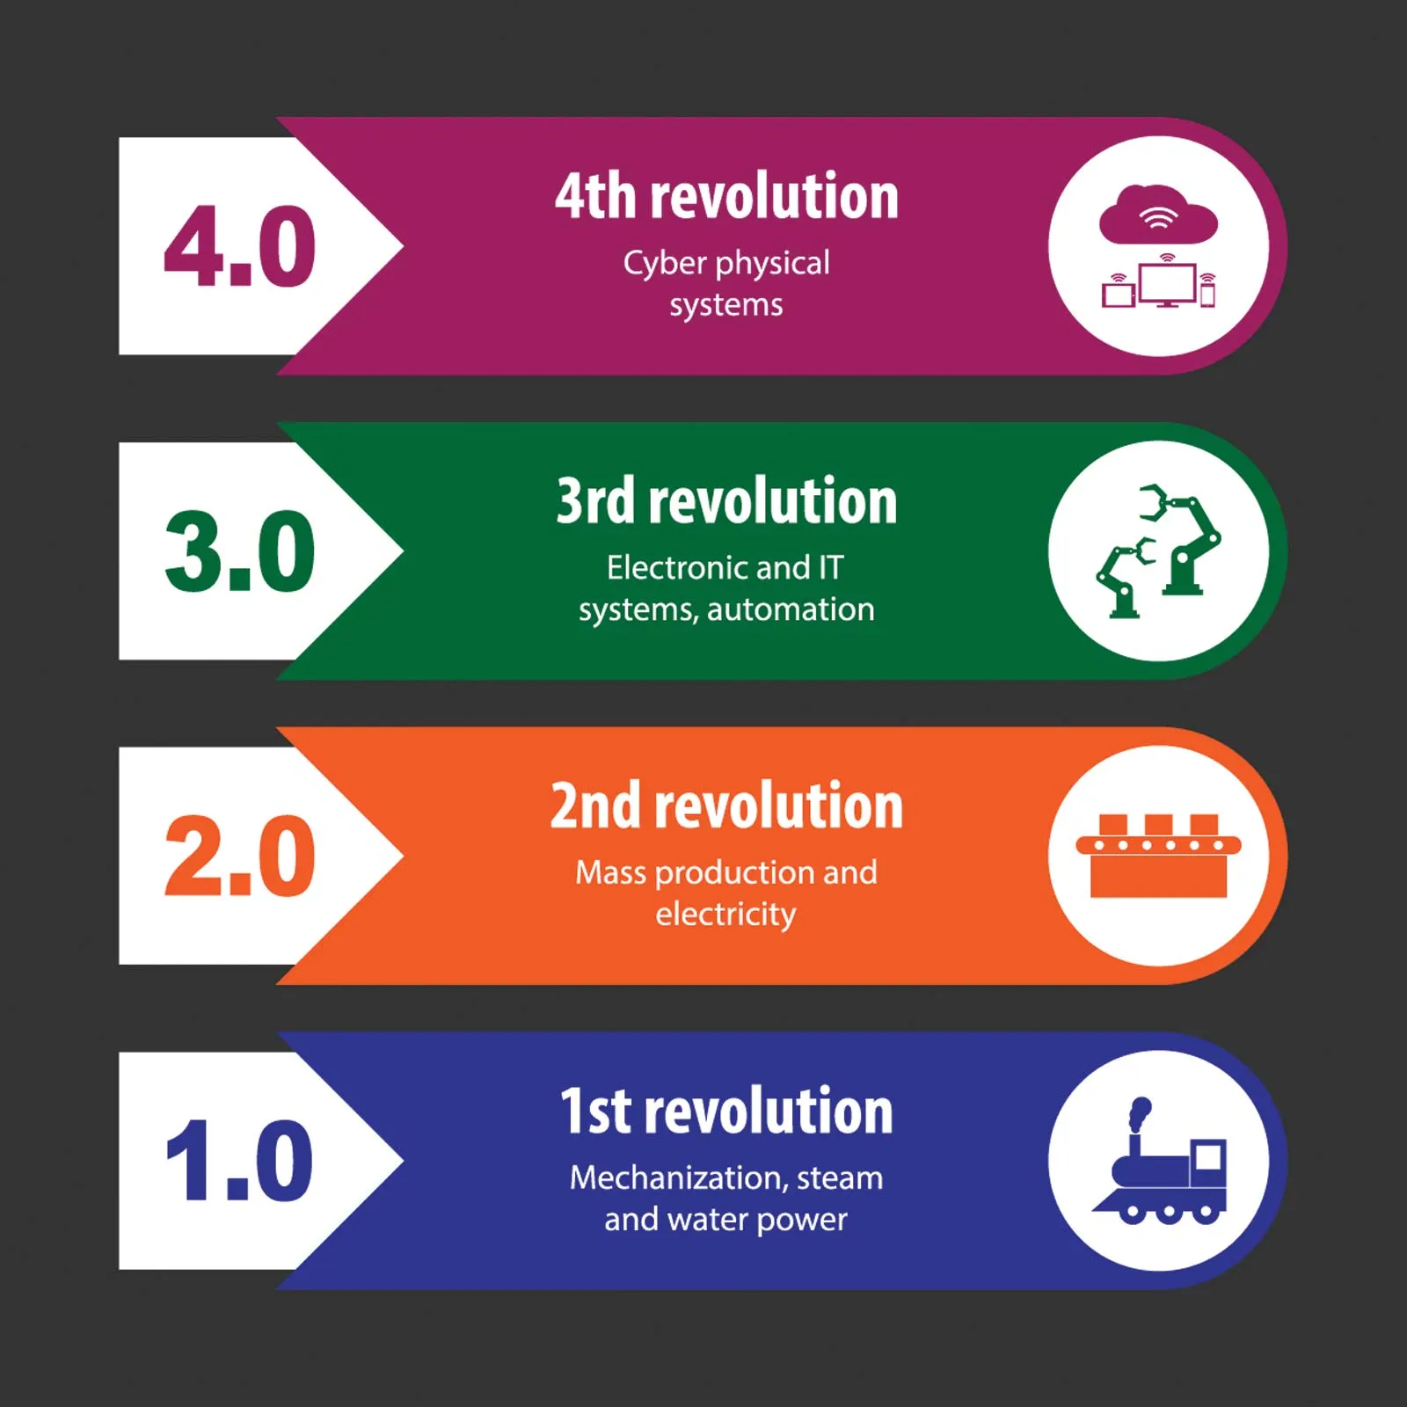
Industrial Revolution

Slide 2
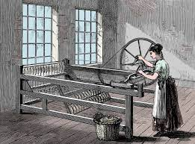
First industrial Revolution: Coal in 1765
Transformed economy from agriculture to industry.
the discovery of coal and its mass extraction
the development of the steam engine and metal forging
Invention of spinning machines and looms to make fabric were making their appearance.
Canal transportation began replacing wagon and mules for moving around these goods.

Slide 3
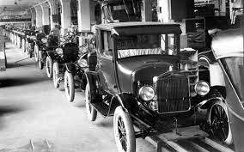
Second Industrial Revolution: Gas in 1870
The discovery of electricity, gas and oil. The invention of the combustion engine went hand-in-hand with these fuel sources.
steel- and chemically based products
It was based on the distribution of electricity.
Developments in communication technology got a jump start with the telegraph and later the telephone.

Slide 4
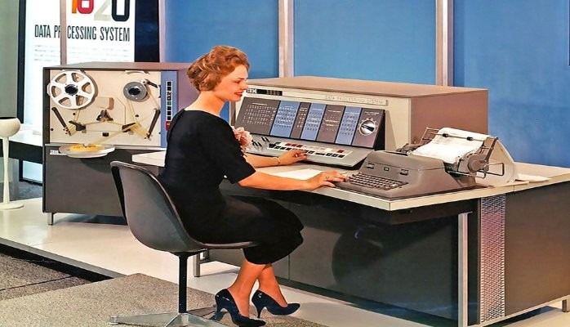
Third Industrial Revolution: Electronics and Nuclear in 1969
Nuclear energy and electronics enter the landscape.
The development of computers, including personal computers (PCs), the “digital” transition.
Nuclear power began in Europe, grew in both Great Britain and the United States, went into remission for years, and grew in Asia.

Slide 5
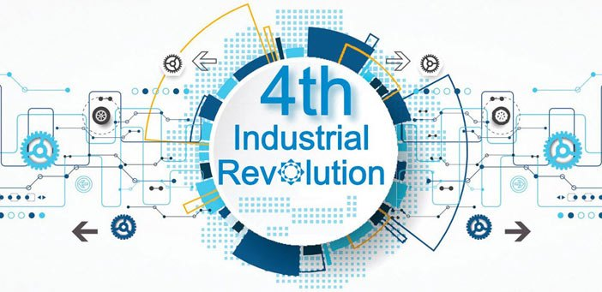
Fourth Industrial Revolution: Internet and Renewable Energy in 2000
Renewable energy such as solar, wind and geothermal.
The fourth Industrial Revolution is moving from an electronic based industry to a process which is the combination of human beings and electronics.
It includes cyber-physical systems, the Internet of things, big data analytics, cloud computing, cognitive computing, artificial intelligence, 3-D printing, and autonomous vehicles etc.
The best example would be processed artificial intelligence has broken the distinction between the Man, The Machine and Intelligence.

Slide 6
Fifth Industrial Revolution
Perceives individuals as partners at work in manufacturing and production organizations.
the fifth industrial revolution will see robots given tasks and decision-making capabilities, primarily aiming to improve quality and production processes.
the fifth industrial revolution will facilitate human well-being. For example, cobots will be the main actors in the essence of Industry 5.0 when it comes to standard tasks such as data mining and drilling, while workers will perform more complex tasks.
the European Commission has announced “Industry 5.0,” which aims for an ideal industry based on the concepts of “sustainability,” “human-centeredness,” .

Slide 7
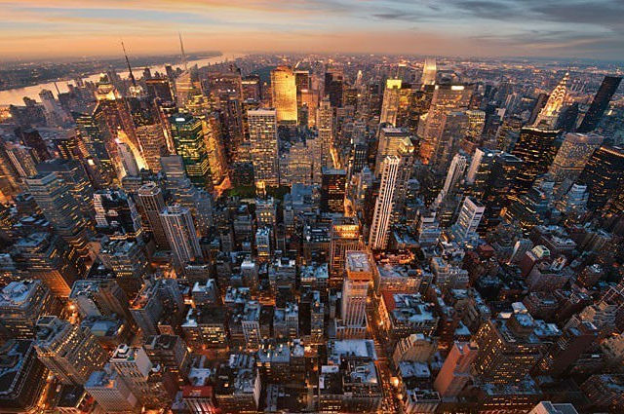
Impact of Industrial Revolution on Society
Transformation of society
During the Industrial Revolution, Europe experienced a shift from a traditional, labor-intensive economy based on farming and handicrafts to a more capital-intensive economy based on manufacturing by machines, specialized labor, and industrial factories.

Slide 8
Impact of Industrial Revolution on Society
Urbanization
The factory system introduced by the Industrial Revolution created cities and urban centers.
In England, cities like Manchester, Birmingham, Leeds, and Sheffield arose .

Slide 9
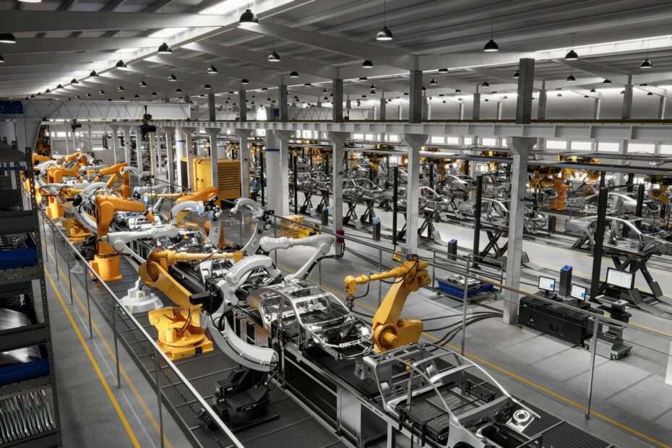
Impact of Industrial Revolution on Society
Machinery
The introduction of power machinery rapidly increased production of goods.

Slide 10
Impact of Industrial Revolution on Society
Employment
The starting of new industries provided employment to many men and women.

Slide 11
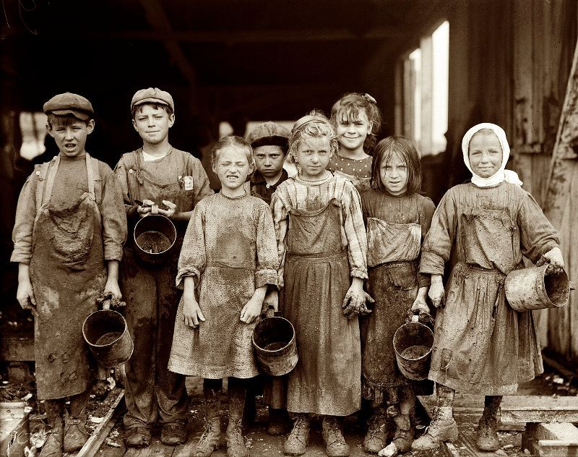
Negative Impact of on Society
New Social Problems
The rapid growth of industrial cities created problems that were difficult to solve .
Hazardous working condition.

Slide 12
Negative Impact of on Society
Working condition
Unquestionably, in the early decades of the Industrial Revolution, “places of work,” as early factories were called, were dreadful. Work hours ranged from twelve to sixteen hours a day, six days a week, with a half hour for lunch and dinner. There was no security of employment and no minimum wage. The worst conditions were in the cotton mills where temperatures were especially debilitating. One report noted that “in the cotton-spinning work, these creatures are kept, fourteen hours in each day, locked up, summer and winter, in a heat of from eighty to eighty-four degrees.”

Slide 13
Negative Impact of on Society
Women and child labor
Women and children were employed for cheap labor. They worked for 12 to 14 hours per day.
Child labor was exploited more than ever and in a considerably more systematic manner. The owners of cotton factories appreciated certain features of child labor. E.g Children had an especially delicate touch as spinners of cotton. Their smaller size made it easier for them to crawl under machines to gather loose cotton.
Children represented a cheap supply of labor. In 1821, they were paid only about one-sixth or one-third of what a man was paid.

Slide 14
Negative Impact of on Society
New Social Problems
Accommodation, sanitation, and health were not provided adequately.
Sickness and crime prevailed.

Slide 15
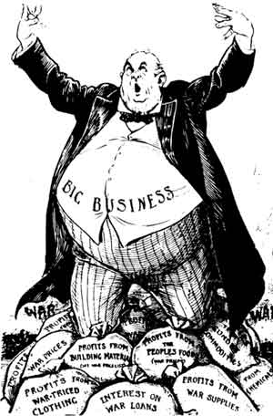
Negative Impact of on Society
Monopoly Capitalism
The establishment of the factory system increased the amount of money in circulation. However , money concentrated in the hands of a few people.

Slide 16
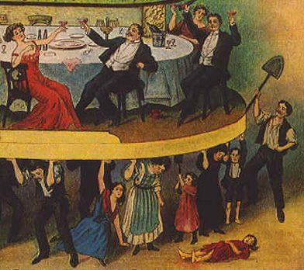
Negative Impact of on Society
Inequality and class struggle
Two distinct group emerged
the rich middle class ( bourgeoisie): composed of manufacturers, merchants , mine owners, bank owners, and professional men, on the one hand,
The wage-earning class (proletariat): composed of mill workers and factory workers, on the other . This gap between employer and employee gave rise to many economic and social problems .

Slide 17
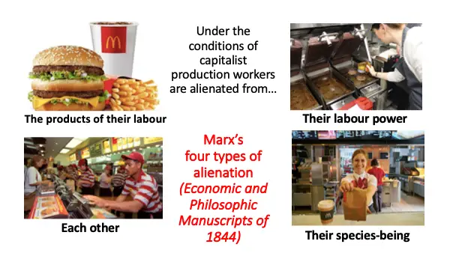
Negative Impact of on Society
Alienation
According to Marx, the structure of capitalism creates alienation. In an industrial society workers confront four type of alienation.
Alienation from product: The product does not belong to them.
Alienation from productive activity
Alienation from him/herself
Alienation from the community/fellows

Slide 18
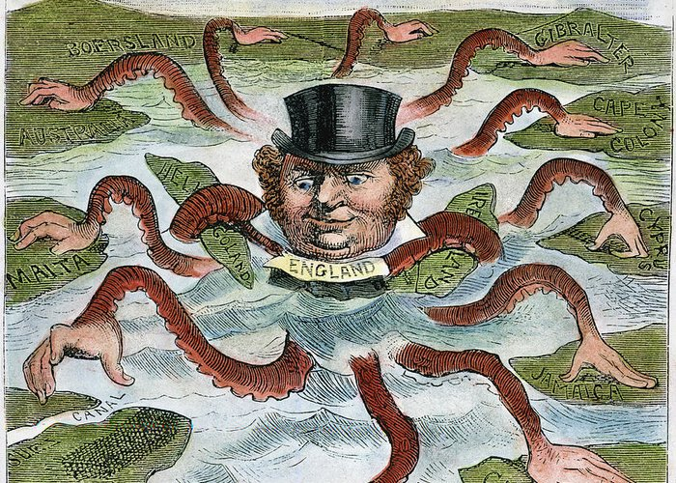
Negative Impact of on Society
Colonialism & imperialism
The Industrial Revolution had strengthened colonialism because the colonies were useful to obtain raw materials and sell the finished products. So, larger territories were captured thus paving way for imperialism.

Slide 19
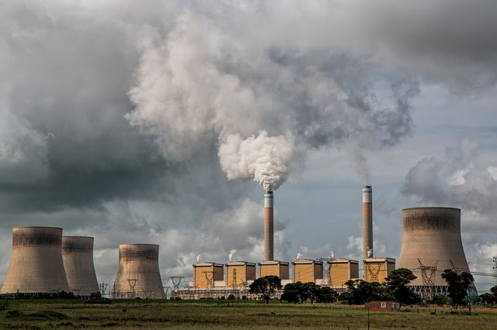
Environmental Impact
The Industrial Revolution was powered by burning coal, and big industrial cities began pumping vast quantities of pollution into the atmosphere.
Air pollution continued to rise in the 1800s, causing respiratory illness and higher death rates in areas that burned more coal.
The burning of fossil fuel pumped carbon into the atmosphere.
Study suggests that climate change driven by human activity began as early as the 1830s.

Slide 20
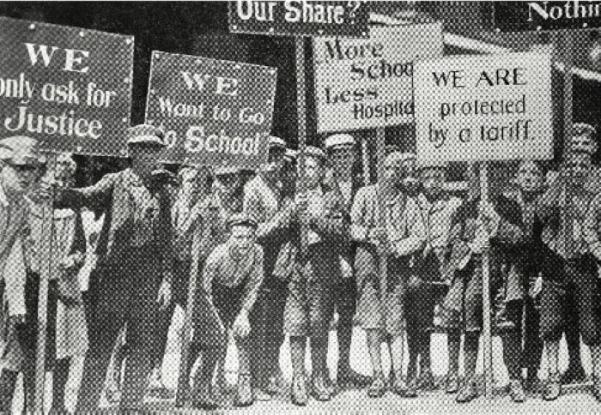
Social Reform
Social Reform Acts
Many factory laws were enacted to improve the lot of the workers between 1833-45 which tried to limit the working hours for children under eleven years of age to nine hours a day and that of women to 12 hours a day.
These Acts also prohibited employment of children in mines and laid down general rules for the health and safety of workers.

Slide 21
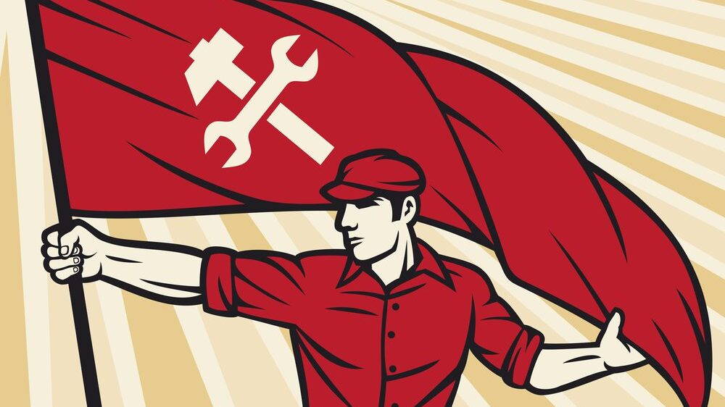
Socialism
The spirit of public welfares and efforts for improving the condition of workers led the socialist movement.
Socialism aimed at establishing equality in society.
The goal of socialism was to eliminate class struggle and form a classless society.

Slide 22
Thank You

